Slide 1
Decision-making

Slide 2
Decision Making
Decision
  Making a choice from two or more alternatives.
The Decision-Making Process
  Identifying a problem and decision criteria and allocating weights to the criteria.
  Developing, analyzing, and selecting an alternative that can resolve the problem.
  Implementing the selected alternative.
  Evaluating the decision’s effectiveness.

Slide 3
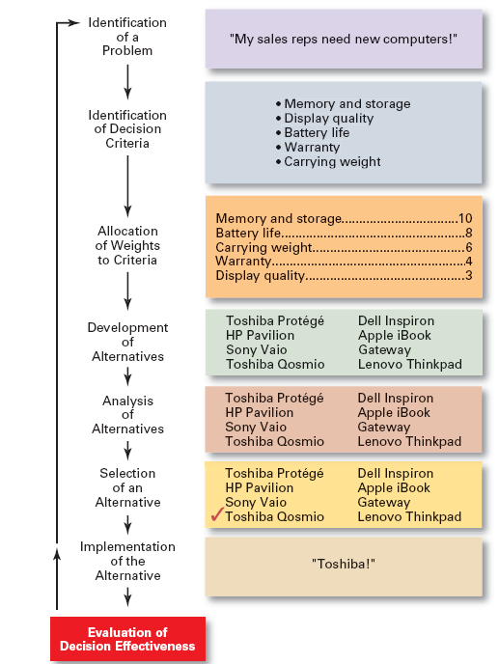

Slide 4
Step 1: Identifying the Problem
Problem
  A discrepancy between an existing and desired state of affairs.
Characteristics of Problems
  A problem becomes a problem when a manager becomes aware of it.
  There is pressure to solve the problem.
  The manager must have the authority, information, or resources needed to solve the problem.

Slide 5
Step 2: Identifying Decision Criteria
Decision criteria are factors that are important (relevant) to resolving the problem.
  Costs that will be incurred (investments required)
  Risks likely to be encountered (chance of failure)
  Outcomes that are desired (growth of the firm)
Step 3: Allocating Weights to the Criteria
Decision criteria are not of equal importance:
  Assigning a weight to each item places the items in the correct priority order of their importance in the decision making process.

Slide 6
Criteria and Weights for Computer Replacement Decision
Criterion Weight
Memory and Storage 10
Battery life 8
Carrying Weight 6
Warranty 4
Display Quality 3

Slide 7
Step 4: Developing Alternatives
Identifying viable alternatives
  Alternatives are listed (without evaluation) that can resolve the problem.
Step 5: Analyzing Alternatives
Appraising each alternative’s strengths and weaknesses
  An alternative’s appraisal is based on its ability to resolve the issues identified in steps 2 and 3.

Slide 8
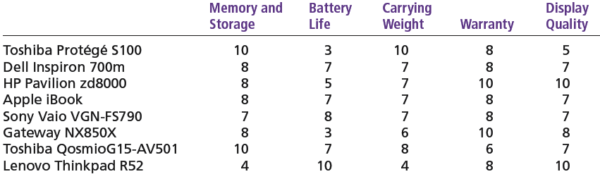
Assessed Values of Laptop Computers Using Decision Criteria

Slide 9
Step 6: Selecting an Alternative
Choosing the best alternative
  The alternative with the highest total weight is chosen.
Step 7: Implementing the Alternative
Putting the chosen alternative into action.
  Conveying the decision to and gaining commitment from those who will carry out the decision.

Slide 10
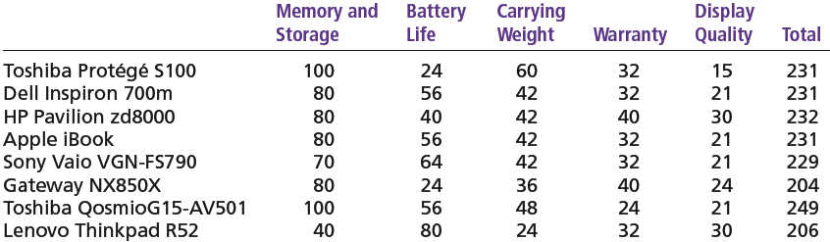
Evaluation of Laptop Alternatives Against Weighted Criteria

Slide 11
Step 8: Evaluating the Decision’s Effectiveness
The soundness of the decision is judged by its outcomes.
  How effectively was the problem resolved by outcomes resulting from the chosen alternatives?
  If the problem was not resolved, what went wrong?

Slide 12
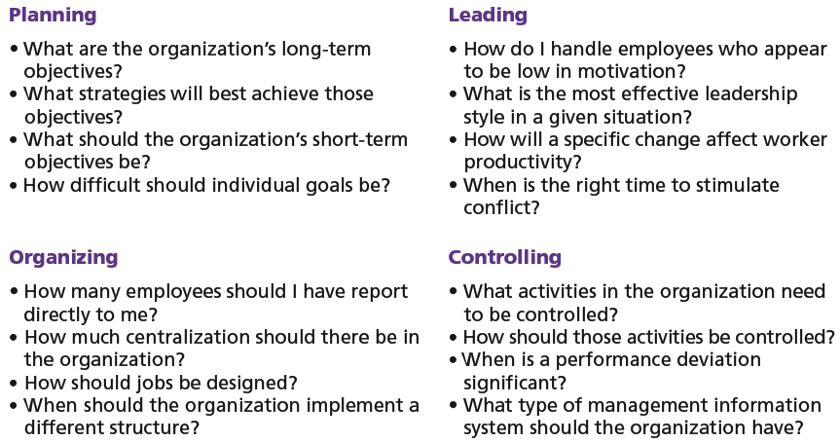
Decisions in the Management Functions

Slide 13
Making Decisions
Rationality
  Managers make consistent, value-maximizing choices with specified constraints.
  Assumptions are that decision makers:
    Are perfectly rational, fully objective, and logical.
    Have carefully defined the problem and identified all viable alternatives.
    Have a clear and specific goal
    Will select the alternative that maximizes outcomes in the organization’s interests rather than in their personal interests.

Slide 14
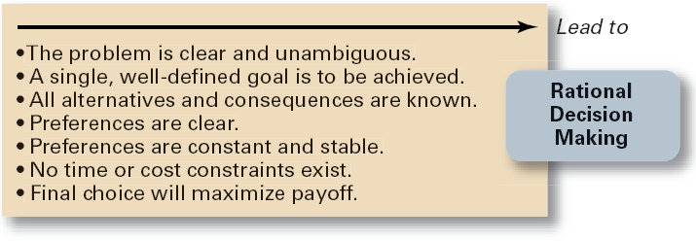
Assumptions of Rationality

Slide 15
Making Decisions (cont’d)
Bounded Rationality
  Managers make decisions rationally, but are limited (bounded) by their ability to process information.
  Assumptions are that decision makers:
    Will not seek out or have knowledge of all alternatives
    Will satisfice—choose the first alternative encountered that satisfactorily solves the problem—rather than maximize the outcome of their decision by considering all alternatives and choosing the best.
  Influence on decision making
    Escalation of commitment: an increased commitment to a previous decision despite evidence that it may have been wrong.

Slide 16
The Role of Intuition
Intuitive decision making
  Making decisions on the basis of experience, feelings, and accumulated judgment.

Slide 17
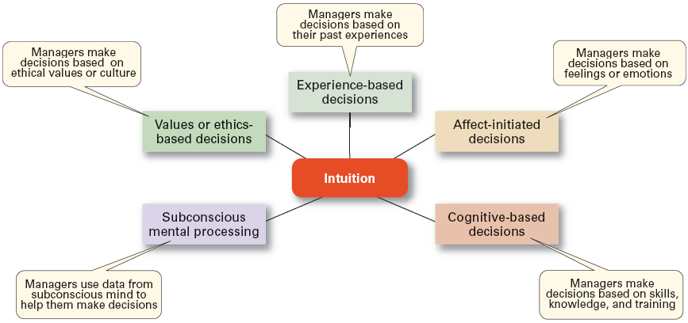
Exhibit 6–7 What is Intuition?

Slide 18
Types of Problems and Decisions
Structured Problems
  Involve goals that clear.
  Are familiar (have occurred before).
  Are easily and completely defined—information about the problem is available and complete.
Programmed Decision
  A repetitive decision that can be handled by a routine approach.

Slide 19
Types of Programmed Decisions
Policy
  A general guideline for making a decision about a structured problem.
Procedure
  A series of interrelated steps that a manager can use to respond (applying a policy) to a structured problem.
Rule
  An explicit statement that limits what a manager or employee can or cannot do.

Slide 20
Policy, Procedure, and Rule Examples
Policy
  Accept all customer-returned merchandise.
Procedure
  Follow all steps for completing merchandise return documentation.
Rules
  Managers must approve all refunds over $50.00.
  No credit purchases are refunded for cash.

Slide 21
Problems and Decisions (cont’d)
Unstructured Problems
  Problems that are new or unusual and for which information is ambiguous or incomplete.
  Problems that will require custom-made solutions.
Nonprogrammed Decisions
  Decisions that are unique and nonrecurring.
  Decisions that generate unique responses.

Slide 22
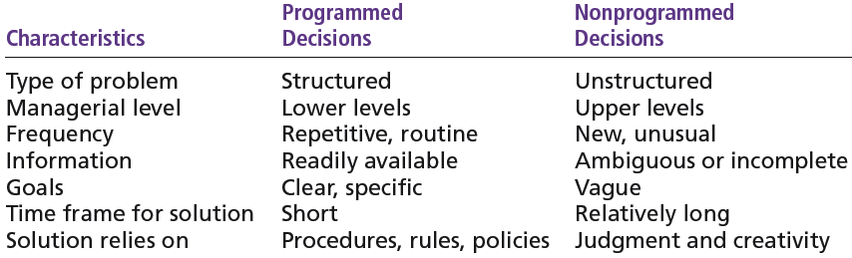
Programmed versus Non-programmed Decisions

Slide 23
Decision-Making Conditions
Certainty
  A situation in which a manager can make an accurate decision because the outcome of every alternative choice is known.
Risk
  A situation in which the manager is able to estimate the likelihood (probability) of outcomes that result from the choice of particular alternatives.

Slide 24
Expected Value for Revenues from the Addition of One Ski Lift
Expected
Expected × Probability = Value of Each
Event Revenues Alternative
Heavy snowfall $850,000 0.3 = $255,000
Normal snowfall 725,000 0.5 = 362,500
Light snowfall 350,000 0.2 = 70,000
$687,500

Slide 25
Decision-Making Conditions
Uncertainty
  Limited information prevents estimation of outcome probabilities for alternatives associated with the problem and may force managers to rely on intuition, hunches, and “gut feelings”.
    Maximax: the optimistic manager’s choice to maximize the maximum payoff
    Maximin: the pessimistic manager’s choice to maximize the minimum payoff
    Minimax: the manager’s choice to minimize maximum regret.

Slide 26
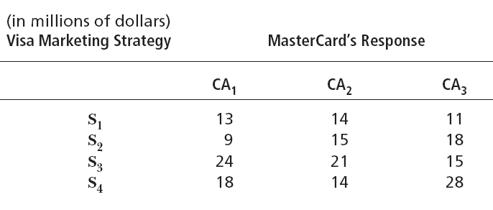
Payoff Matrix

Slide 27
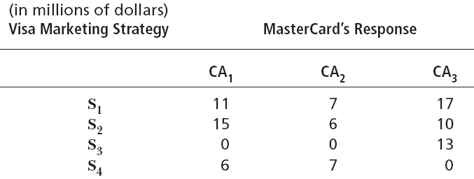
Regret Matrix

Slide 28
Decision-Making Styles
Dimensions of Decision-Making Styles
  Ways of thinking
    Rational, orderly, and consistent
    Intuitive, creative, and unique
  Tolerance for ambiguity
    Low tolerance: require consistency and order
    High tolerance: multiple thoughts simultaneously

Slide 29
Decision-Making Styles (cont’d)
Types of Decision Makers
  Directive
    Use minimal information and consider few alternatives.
  Analytic
    Make careful decisions in unique situations.
  Conceptual
    Maintain a broad outlook and consider many alternatives in making decisions.
  Behavioral
    Avoid conflict by working well with others and being receptive to suggestions.

Slide 30
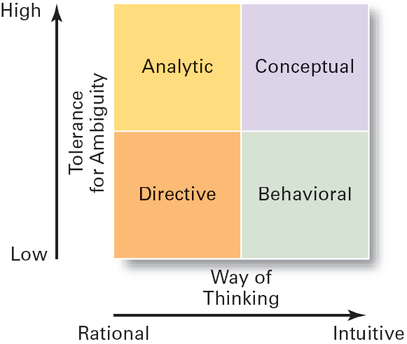
Decision-Making Matrix

Slide 31
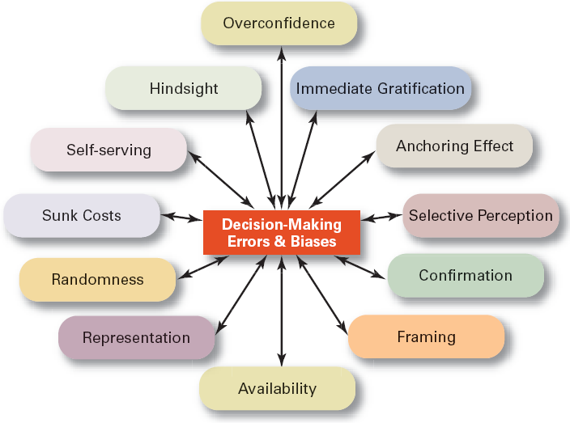
Common Decision-Making Errors and Biases

Slide 32
Decision-Making Biases and Errors
Heuristics
  Using “rules of thumb” to simplify decision making.
Overconfidence Bias
  Holding unrealistically positive views of one’s self and one’s performance.
Immediate Gratification Bias
  Choosing alternatives that offer immediate rewards and that to avoid immediate costs.

Slide 33
Decision-Making Biases and Errors (cont’d)
Anchoring Effect
  Fixating on initial information and ignoring subsequent information.
Selective Perception Bias
  Selecting organizing and interpreting events based on the decision maker’s biased perceptions.
Confirmation Bias
  Seeking out information that reaffirms past choices and discounting contradictory information.

Slide 34
Decision-Making Biases and Errors (cont’d)
Framing Bias
  Selecting and highlighting certain aspects of a situation while ignoring other aspects.
Availability Bias
  Losing decision-making objectivity by focusing on the most recent events.
Representation Bias
  Drawing analogies and seeing identical situations when none exist.
Randomness Bias
  Creating unfounded meaning out of random events.

Slide 35
Decision-Making Biases and Errors (cont’d)
Sunk Costs Errors
  Forgetting that current actions cannot influence past events and relate only to future consequences.
Self-Serving Bias
  Taking quick credit for successes and blaming outside factors for failures.
Hindsight Bias
  Mistakenly believing that an event could have been predicted once the actual outcome is known (after-the-fact).

Slide 36
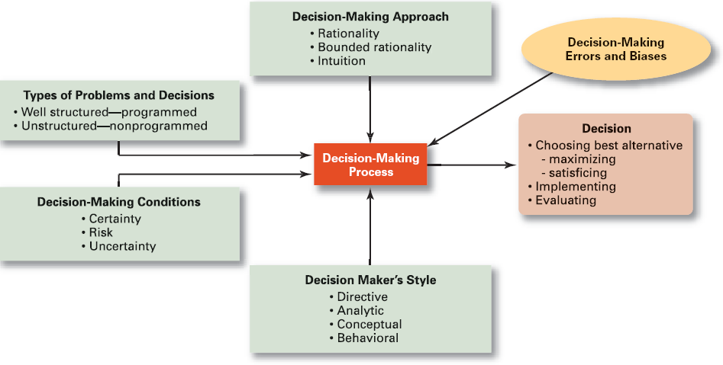
Overview of Managerial Decision Making

